Slide 1
EMPLOYEE MANAGEMENT SYSTEM
Presented by:
Zuhair Arif - 24504
Danish Raza - 24796
Zarlish Mohtasham – 24452
Fatima Tanveer - 25183

Slide 2
WHAT IS EMS?
Maintains the details of each employee in a respective area.
Overrides the problem of keeping records of thousands of employees manually.
Handled by one admin therefore more efficient.
Maintains the personal and official details of the employees.

Slide 3
OBJECTIVES OF OUR PROJECT
Aims to simplify the task of maintaining records of the employees of the respective company.
To design a well-developed login page, home page using various concepts of inheritance, exceptional handing, overriding in OOP via GUI on NetBeans.
Allows the admin to create and manage the details of the employee.
Allows the employee to view their details.
Objective is to provide a comprehensive approach towards the management of employee information.

Slide 4
PROPOSED SYSTEM
Helps in maintaining the computerized employee details.
Calculates the salary of permanent and part-timer employees.
Throws CustomException if working hours are exceeded.
Creates new users to the system accordingly.
The details are only managed by one admin.
The employees can view their details respectively.

Slide 5
SOFTWARE DESIGNS

Slide 6
LOG IN
USER
PASSWORD
SIGN IN
Admin Dashboards
Employee Dashboard

Slide 7
ADMIN
HOME
SEARCH
CREATE
REMOVE
Reset Week
Search an Employee
First Name
Last Name
Remove an Employee
Email
E-ID
Password
Phone
Male / Female
Part-time / Full- time

Slide 8
MODULES
ADMIN:
HOME
CREATE
SEARCH
REMOVE

Slide 9
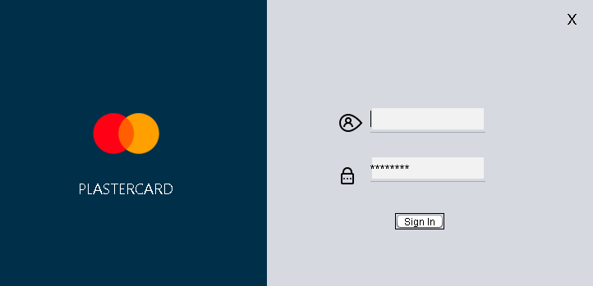
LOG-IN AUTHENTICATION USER
User: admin
Password: admin
by default

Slide 10
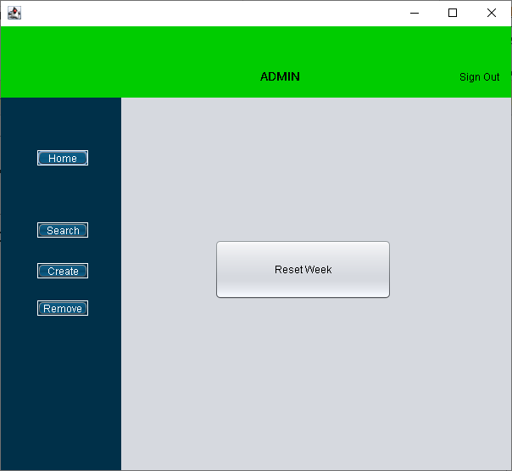
EMPLOYEE RECORD FORM - HOME

Slide 11
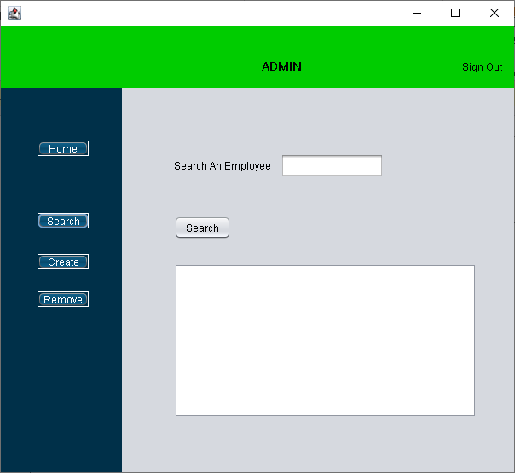
EMPLOYEE RECORD FORM - SEARCH
Enter ID to search an employee.

Slide 12
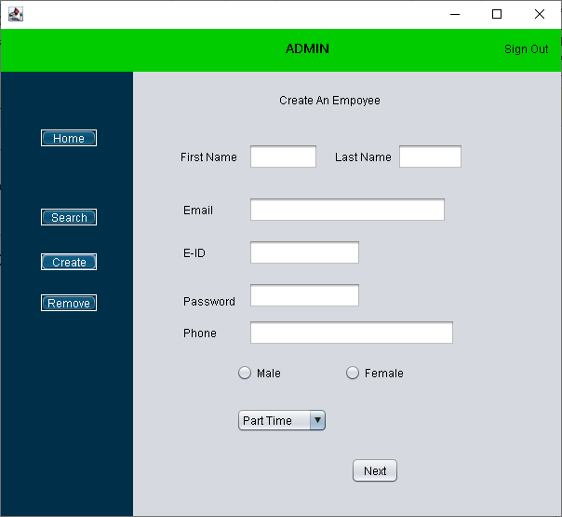
EMPLOYEE RECORD FORM - create
Enter all the details and proceed further.

Slide 13
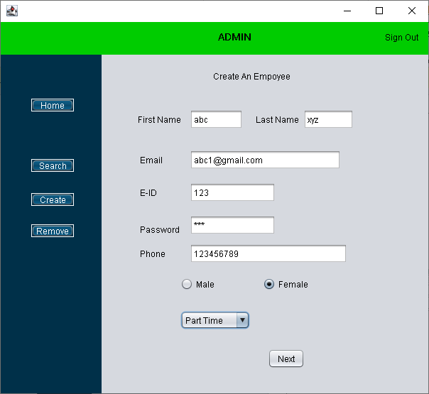

EMPLOYEE RECORD FORM – create (cntd..)
PART TIME
FULL TIME

Slide 14
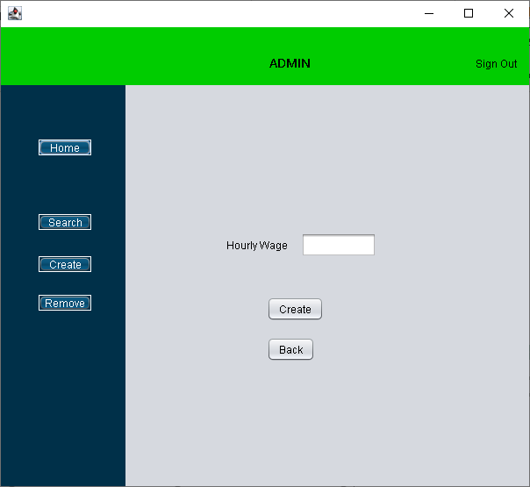
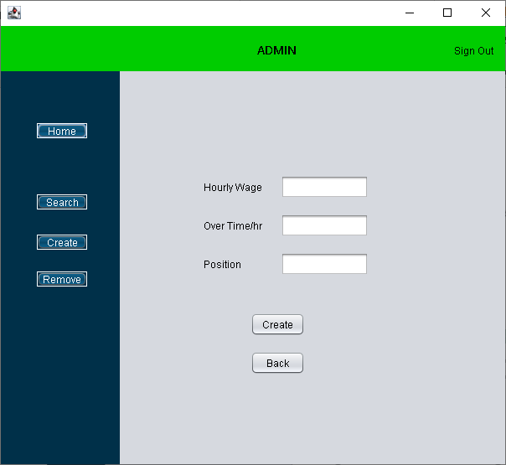
EMPLOYEE RECORD FORM – create (cntd..)
PART TIME
FULL TIME

Slide 15
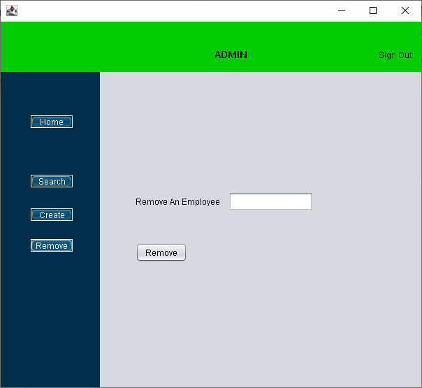
EMPLOYEE RECORD FORM - remove
Enter the employee ID and remove the employee from the record.

Slide 16
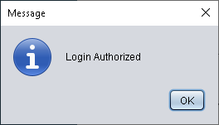
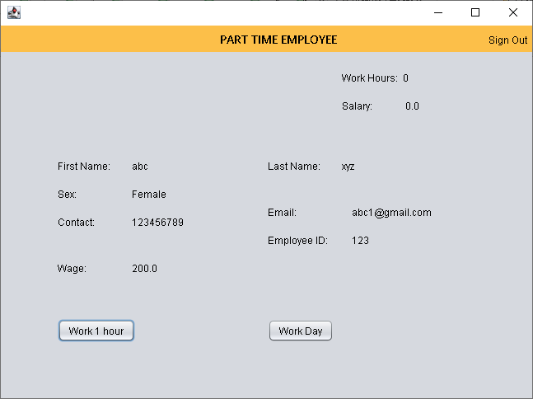
LOG IN AUTHENTICATION FORM

Slide 17
ADVANTAGES
More efficient and reliable.
Less time consuming and easy to use.
Avoid data inconsistency and redundancy.
Huge data storage with less computer memory.
Reduces efforts for maintaining daily data.
Avoids data manipulations.
Provides computerized system for maintaining daily data.

Slide 18
LIMITATIONS
Employee will not be allowed to alter his/her details.
Will run on only one PC or laptop.
Therefore, employee and admin have to refer to the same PC.
No network connection.

Slide 19
WHY CHOOSE JAVA SWING
Swing Components are plat-form independent.
Swing components are light weight.
Swing supports pluggable look and feel.
Provides various components such as labels, text boxes, buttons, etc.
Highly customizable.

Slide 20
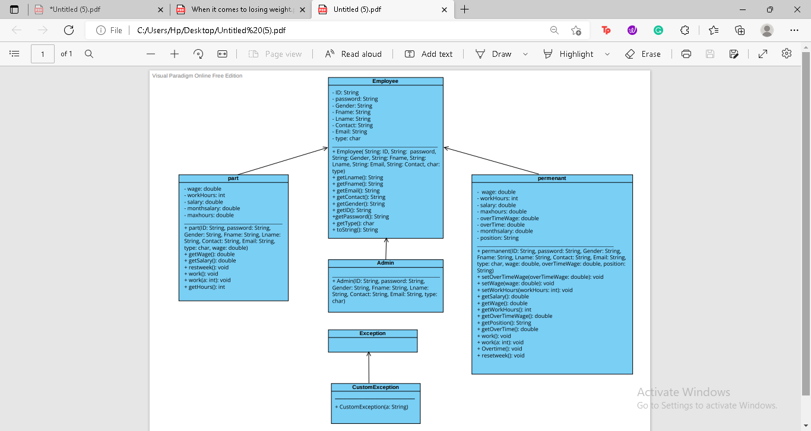

UML DIAGRAM

Slide 21
THANK YOU

